Slide 1
ADAS Requirements, market status and pay-per-use model
Futurewei IT
Boston Storage and Data Management Lab

Slide 2
Key ADAS customer requirements
Economically flexible
Solution must be economically flexible. E.g., either public clouds, on-prem solution with pay-per-use model, or hybrid cloud.
Ecosystem friendly
Solution must be compatible with the mainstream ML/DL/ADAS ecosystems.
Open to new solutions.
Efficient computation
Solution must have the capability to process the data with geo-and-tier mobility (data mobility) and drive out business value in the shortest time.

Slide 3
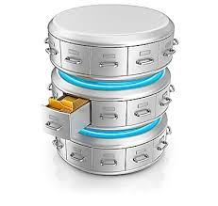
Requirements
Economical
Eco-friendly
Efficient
过往Volvo项目信息
阶段 | 数据收集和预处理 | AI训练 | 验证和仿真&分析 | 数据备份和归档
核心诉求 | 支持百PB级海量扩展 | 支持海量小文件极致OPS和极致时延 | 支持高带宽 | 海量，高密，低成本，长时间保存（36年）
Process, Sample, Reduce
Sensor & Algorithm
Control Logic Validation
AI Training
Dvlp+Test(Open loop)
Software in loop
Test Vehicle
Ingest/Store
Generate code
Integrate
Build
Performance Simulation
Hardware in loop
传感器原始数据 & CAN Bus数据
Render/convert
Tag
Replay
Simulate
Physical Test-Drive
场景评测KPI
纵向
：基于业务流程
，多协议访问
，避免数据格式转换
标注数据
ML数据集->机器学习->模型
算法/模型部署
场景数据
NFS
SMB/NFS
NFS
NFS/S3/HDFS
SMB/NFS/S3/HDFS互通
100 PB级别
10PB 级别
TB 级别
100TB 级别
5GB/s Through
1ms latency
100,000+ OPS
20GB/s + Throughput
High density
Low cost
Migration-free
Tiering
Global Access
Multi-Tenancy
WORM
横向：基于数据生命周期管理，数据按需流动，避免数据的物理拷贝

Slide 4
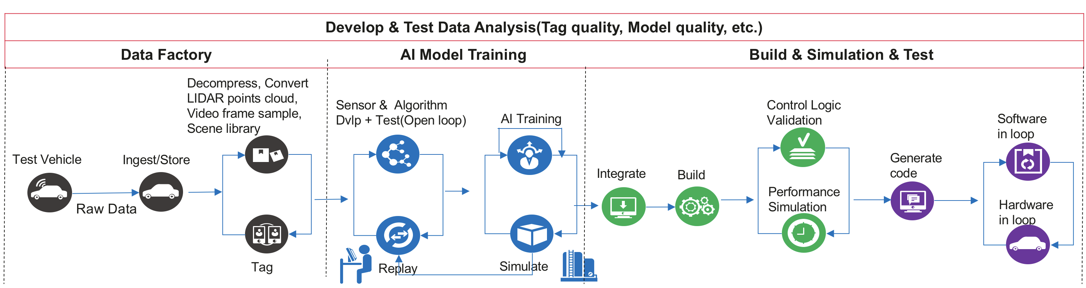


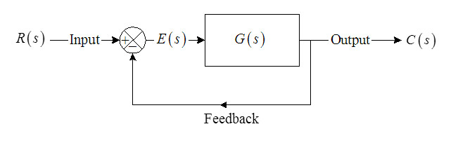
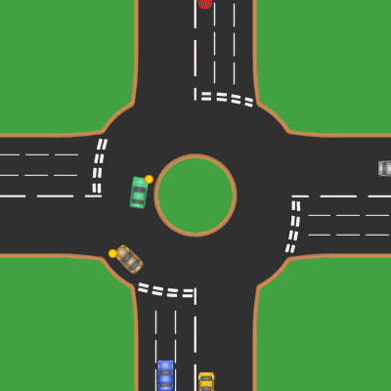
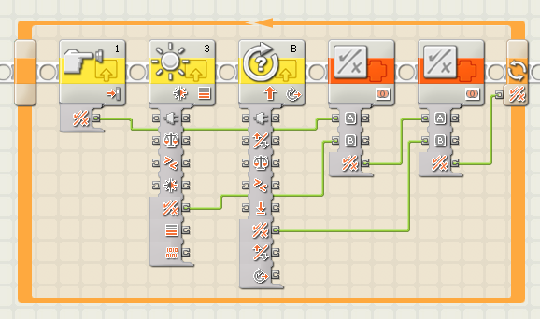





Requirements
Economical
Eco-friendly
Efficient
Understanding ADAS Development Process
Road test Data collection
Data Ingestion, preparation
Simulation, modeling and training
Verification in lab
Training set
generator
Training staff
Drivers on the road
Lab testing staff
Cleaning
Control Model development
Software in loop
Training data set
Simulation
Automated and manual
Tagging
AI training
Hardware in loop
~60TB per day per vehicle
Hundreds of PB
Hundreds of TB
Dozen of PB

Slide 5
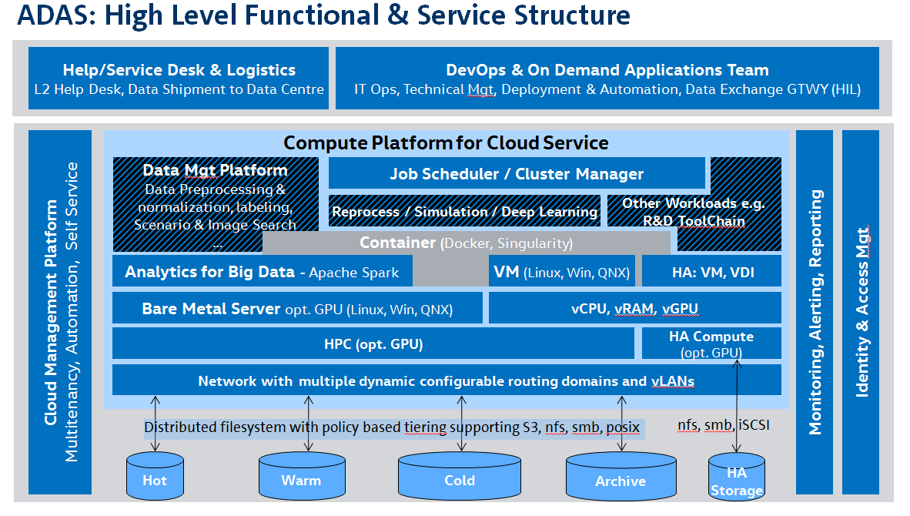
Requirements
Economical
Eco-friendly
Efficient
Volkswagen’s view (Source: VW ADAS IT Platform RFI 02/2019)

Slide 6
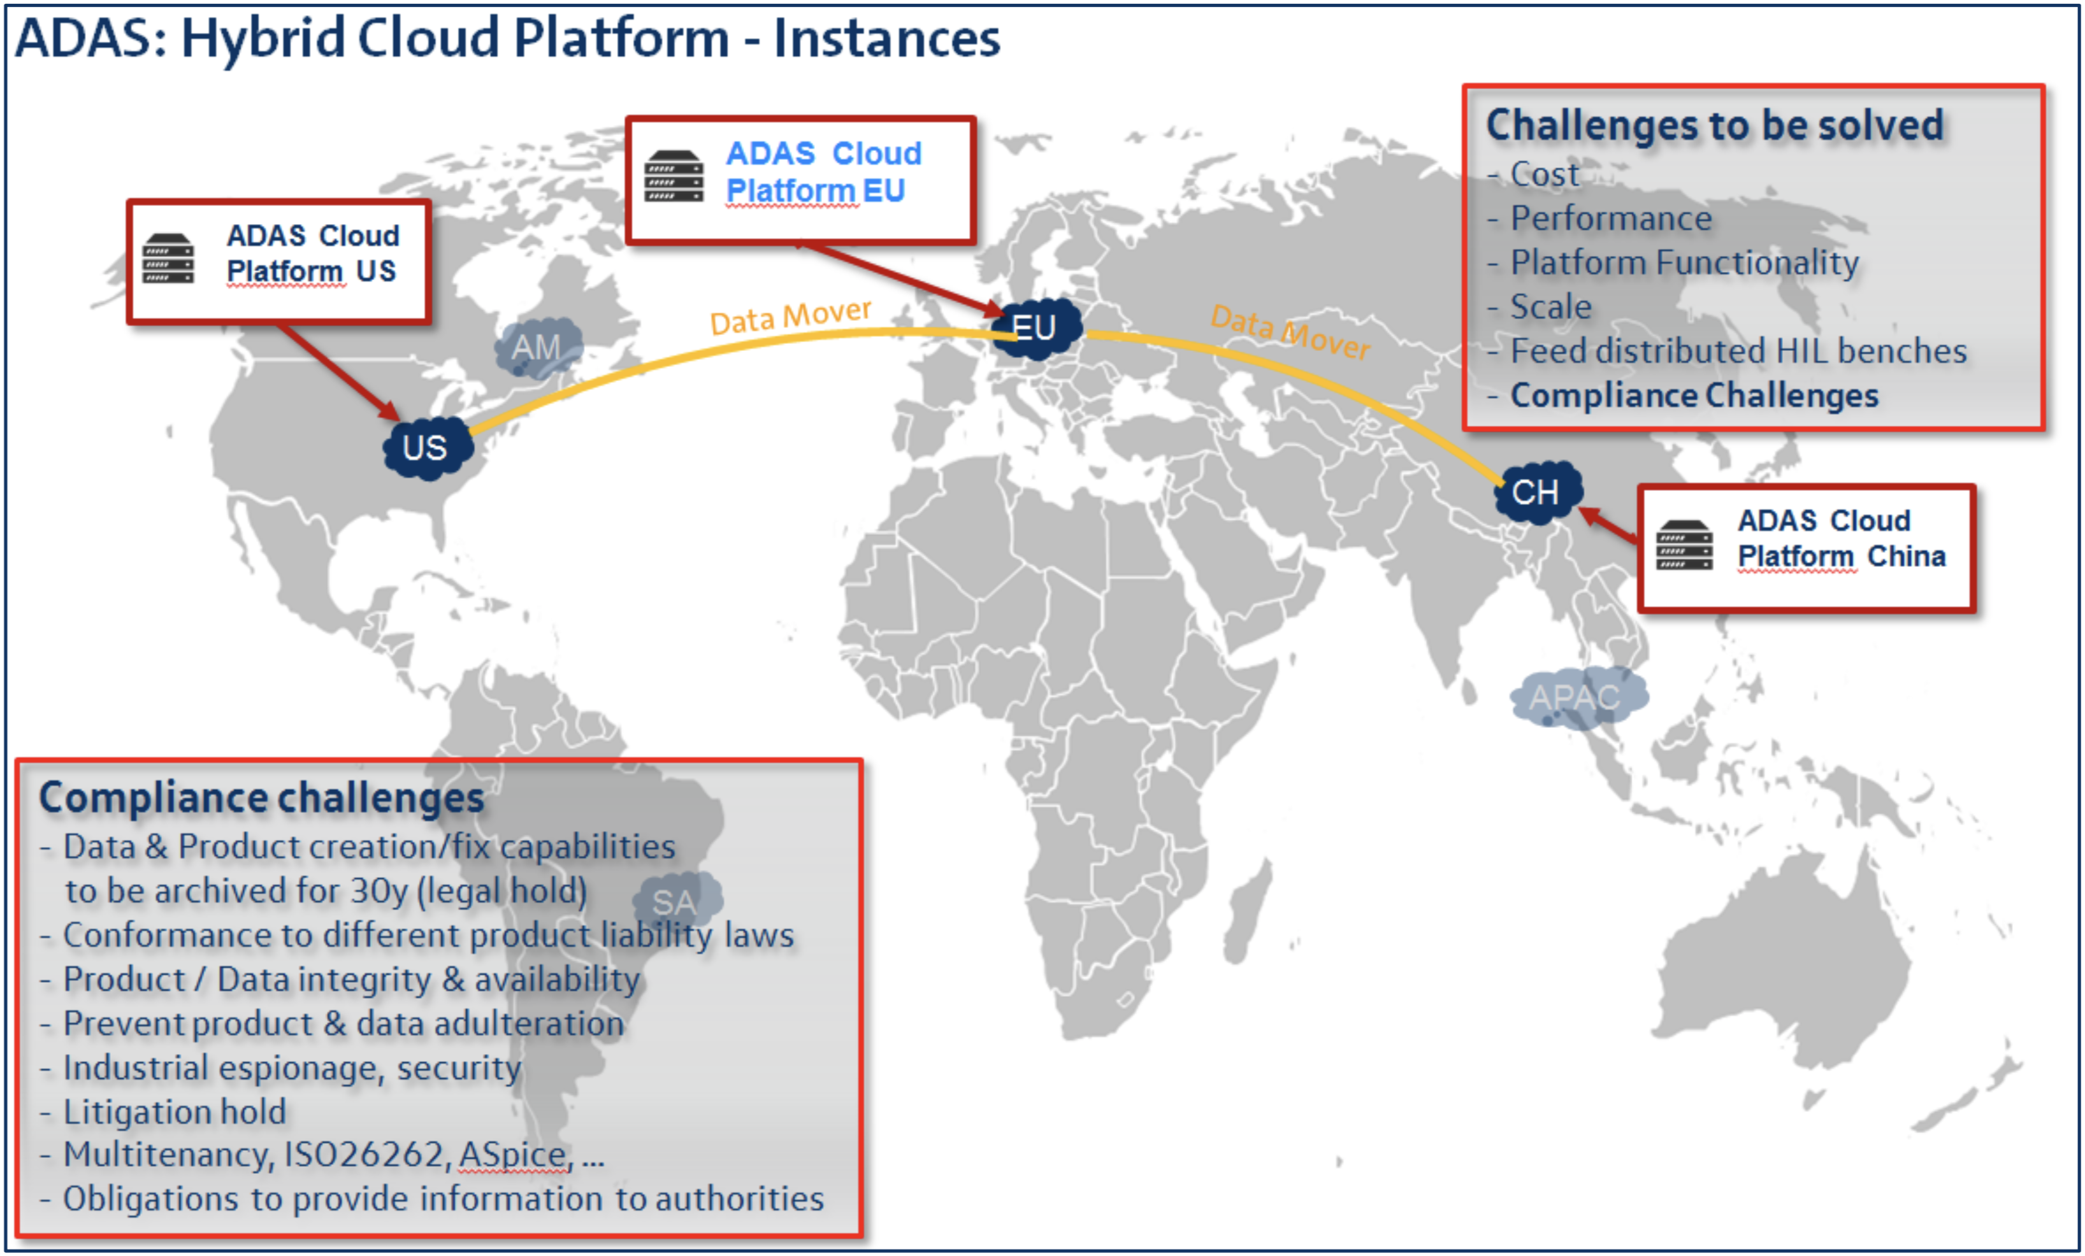
Requirements
Economical
Eco-friendly
Efficient
VW: ADAS WorldWide Deployment Requirements (Source: VW ADAS IT Platform RFI 02/2019)

Slide 7
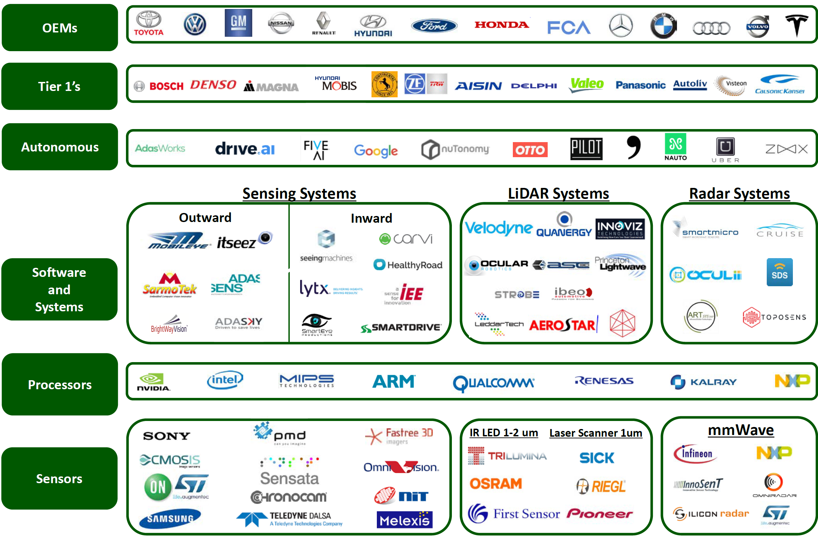
WCP: Automotive Sensing Systems - Market Player Map
Requirements
Economical
Eco-friendly
Efficient
Huawei
We want to be here.
Source: Beyond The Headlights: ADAS and Autonomous Sensing, Woodside Capital Partners, Sep 2016

Slide 8
Economical concerns
Different storage tiers to satisfy IO requirements
Pay-per-use model
Total cost of ownership (public cloud vs. on-prem)

Slide 9
Advanced Driver Assisting System (ADAS) process view
Requirements
Economical
Eco-friendly
Efficient
Four processing stages of ADAS
Road test Data collection
Data Ingestion and preparation
Simulation, modeling and training
Verification in lab
Training set
generator
Training staff
Lab testing staff
Testing staff on the road
Automated and manual
Cleaning
Control Model development
Simulation
Software in loop
Training data set
Tagging
AI training
Hardware in loop
~60TB per day per vehicle
Hundreds of PB
Hundreds of TB

Slide 10
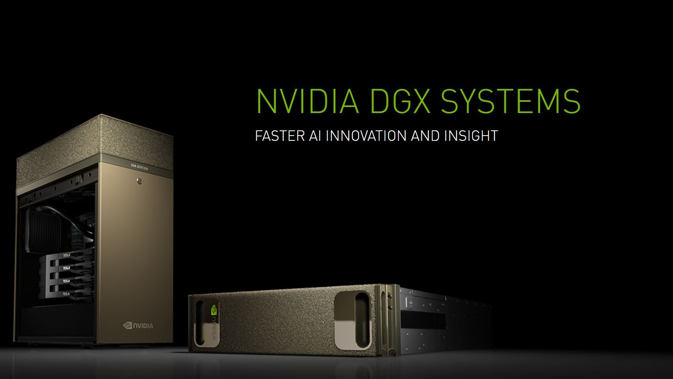






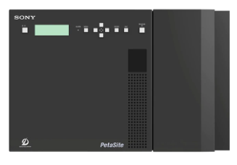

ADAS on-prem Storage Solution Recommendation
Requirements
Economical
Eco-friendly
Efficient
Road test Data collection
Data Ingestion and preparation
Simulation, modeling and training
Training set
generator
Simulation
Control Model development
AI training
Testing staff on the road
Cleaning
Tagging
Training data
Training staff
Huawei Servers Compute and VDI
ArcticOcean like storage box
Huawei FusionServer VDI
Storage Link
Distributed NAS
Object, HDFS
OceanStor 100D
NAS on all-flash Dorado
Backup and archive
Storage Link
Distributed NAS
Object, HDFS
Software in loop
Hardware in loop
Cloud
Lab testing staff
OceanStor 100D
SONY optical disk archive
Backup and Archiving
Verification in lab

Slide 11


Global Storage Product Deployment (including backup and archive)
Requirements
Economical
Eco-friendly
Efficient
European site
North American site
Asian site
VDI
VDI
VDI
APPS
APPS
APPS
A
Dorado
Dorado
Dorado
Dorado
Dorado
Dorado
B
OceanStor 100D
OceanStor 100D
OceanStor 100D
OceanStor 100D
C
OceanStor 100D
OceanStor 100D
Backup and archive
Cross site links
Backup and archive
Backup and archive
Cross site data links (subject to regulations such as GDPR)
D
Intra site links
E
External cloud

Slide 12
Requirements
Economical
Eco-friendly
Efficient
What is Pay-per-use?
Pay-per-use is a market strategy that allows customers to only pay based on consumption of resources.
Also known as “pay as you go”.
HPE’s Greenlake is an enterprise supported solution to offer customers a pay as you go environment. It aims to compete with not only traditional IT vendors but also public cloud vendors and hybrid cloud providers.
For an overview of greenlake, please check out its official website
https://www.hpe.com/us/en/greenlake/overview.html
Covers a broad range of services needed by enterprises, from database to big data, from storage to HPC.

Slide 13




Why did customers choose Greenlake?
Requirements
Economical
Eco-friendly
Efficient
and ease the customer’s concern of vendor lock in.
Ecosystem
$2.8 billion in total contract value,
and over 600 customers
HPE plays a service provider role.
Collaboration with all major players in the industry.
Public cloud vendors, storage vendors, data management vendors, etc.
It aims to solve two pain points,
Cost saving
Ease of use and management
EVERYTHING is metered!
Professionally managed!
Not paying for unused resources.
Single vendor covers all.
Consumption analytics
Visibility/control/capacity planning
Storage consumed
Interactive charts/graphs (insight)
Automate capacity planning
Single vendor support for public and private clouds
Pay as you go, consume-based IT
HPE pointnext services, infrastructure as code.
HPE adaptive management services.

Slide 14
Business model – A win-win strategy
Requirements
Economical
Eco-friendly
Efficient
Usage
Auto-provisioned
Billed based on committed usage
Actual usage
Committed usage for basic contract
Max(actual usage, committed usage)
Actual charge
(Billed)
HPE is seeing on average a 22 – 30 percent cash flow savings with customers adopting the GreenLake model
Claims to be 3 times cheaper than AWS in some cases.
https://www.crn.com/slide-shows/channel-programs/300106216/5-reasons-hpe-greenlake-is-a-hit.htm
https://community.hpe.com/t5/ai-insights/comparing-hpe-on-premises-infrastructure-vs-amazon-web-services/ba-p/7019674#.XsWNbmhKiXI

Slide 15


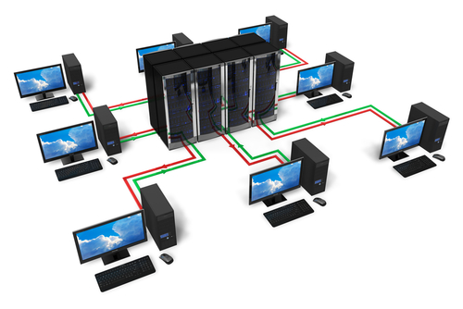



Common Pay-per-use requirements
Requirements
Economical
Eco-friendly
Efficient
Admin User
Billing
Budgeting and
Metering service
Data center services
Managed service team
System Administration service
Public cloud services

Slide 16
Ecosystem concerns
Dominant industry leaders
Open-source software is widely adopted; there are also many commercial vendors
Both public clouds and on-prem must be ecosystem friendly
Multi-vendor interoperability, support, and integration

Slide 17


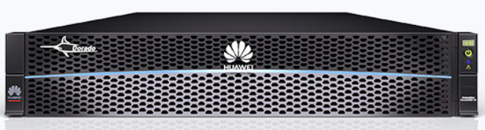
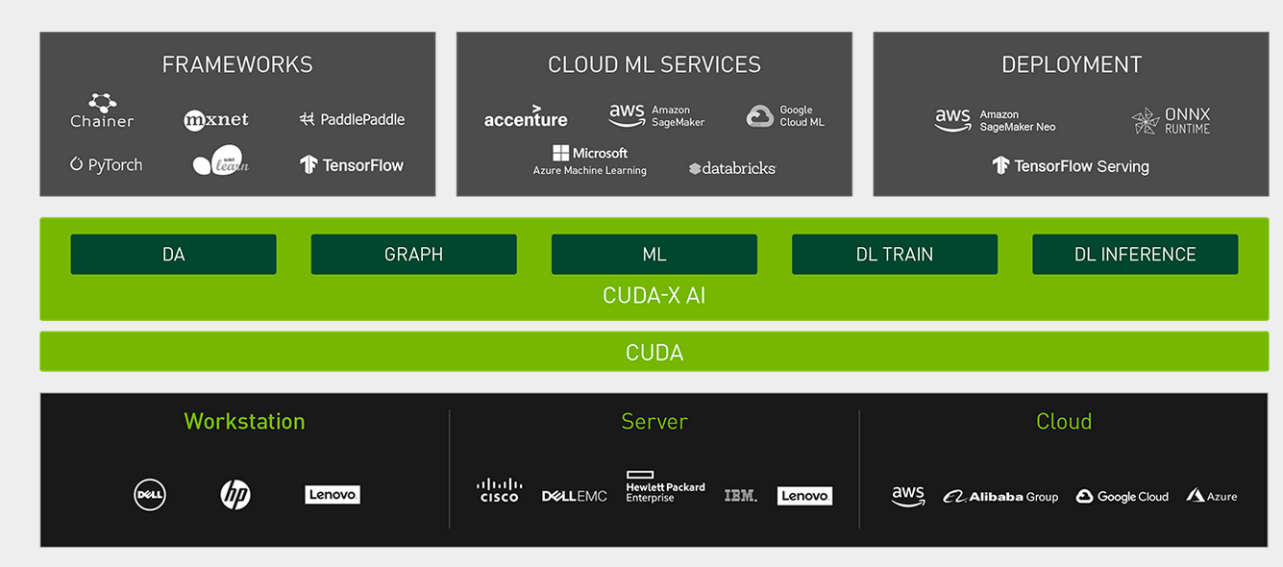


Nvidia ecosystem
Requirements
Economical
Eco-friendly
Efficient
storage
network
DGX-2
DGX-2
DGX-2 ready systems.
Each DGX-2:
16 Tesla V100 GPUs
Source: https://www.nvidia.com/en-us/data-center/magnum-io/

Slide 18
Open-source ecosystem with Nvidia GPUs
Requirements
Economical
Eco-friendly
Efficient
Software
Configuration
Common
Vertical (ADAS, BIO) training
ADAS
Simulation
Big data tools
AI
Apollo
Jupyter hub
Caffe
Erdos
Python3
GPU monitoring
Horovod
Ray
Keras
CARLA
GPU scheduler
Spark Stream
Spark SQL
Spark ML
MXNet
Pytorch
Docker
Spark core
TensorFlow
Prometheus
Alluxio
K8S
Grafana
Java
Nvidia container runtime
Kafka
GCC
CUDA-X
Argo workflow
Scala
CUDA
Host 1
Host n
Remote storage
System
Configuration
NVMe driver
AWS
GPU
GPU
GPU
GPU
LUNs
GPU driver
Files
Azure
Nvidia CPUs
NFS
Objects
Google Cloud
Multi-GPU NVlink
Multi-GPU NVlink
NIC
NIC
NIC
Extended solution
Multi-host connected by high speed RDMA network (IB/RoCE)
Connect to storage with NVMe over Fabric (IB/RoCE)

Slide 19
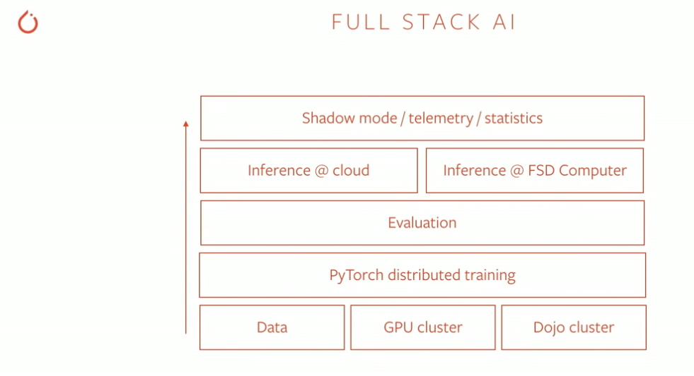
Different customer styles
Requirements
Economical
Eco-friendly
Efficient
Self built from scratch (A small group)
E.g., Tesla
No LIDAR, No high-def map
FSD (full self-driving) chip for inference
Dojo (training with own chip)
Embrace open-source ecosystem (PyTorch)
Adopt industrial turn-key solutions (Most customers)
Most are Nvidia GPU based (others include Google TPU, etc)
Embrace open-source
Commercial vendors too
Source: PyTorch at Tesla - Andrej Karpathy,PyTorch developer conference 2019 https://www.autopilotreview.com/teslas-andrej-karpathy-details-autopilot-inner-workings/

Slide 20
Commercial turn-key vendors
Requirements
Economical
Eco-friendly
Efficient
Data center
Nvidia
Dell EMC
IBM
Netapp
HPE
Public clouds
AWS ADAS
Azure
Google cloud
Alibaba cloud
Huawei cloud
Many solutions need a composition of multiple vendors

Slide 21
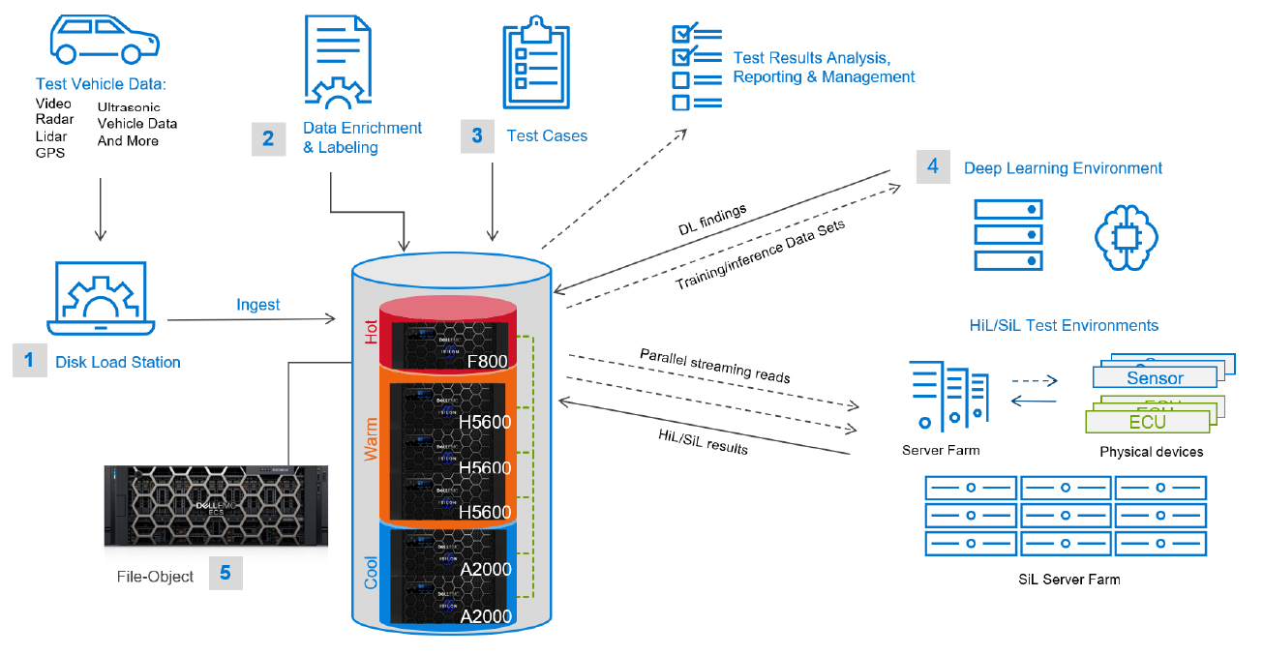
Vendor solutions
Requirements
Economical
Eco-friendly
Efficient
Source: (white paper) Dell EMC Isilon: Deep learning infrastructure for autonomous driving
https://www.delltechnologies.com/en-ca/collaterals/unauth/white-papers/solutions/h17918_deep_learning_infrastructure_for_autonomous_driving.pdf

Slide 22
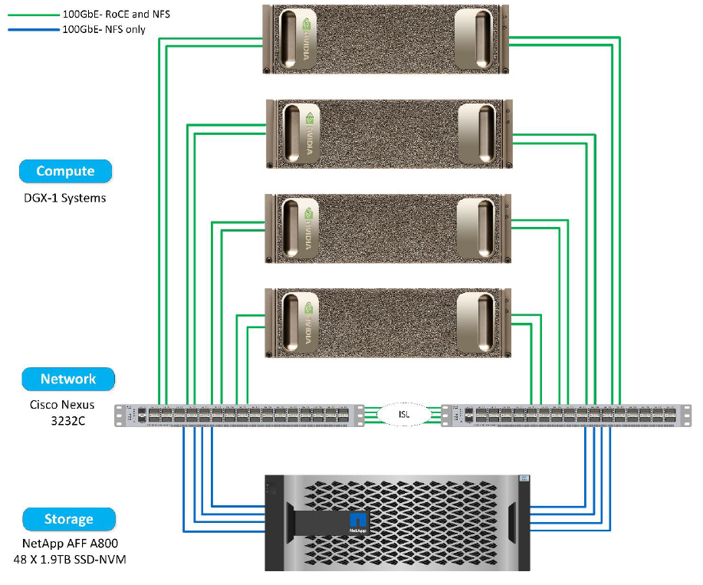
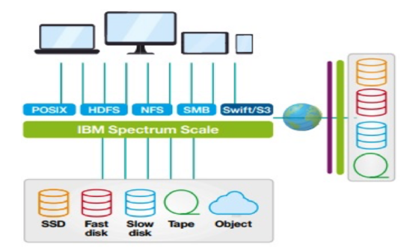
Requirements
Economical
Eco-friendly
Efficient
Source: (white paper) IBM Storage for Advanced Driver Assistance Systems (ADAS) and Autonomous Driving (AD)
https://www.ibm.com/downloads/cas/GA1X5W4Q
Source: (white paper) NetApp ONTAP AI Reference Architecture for Autonomous Driving Workloads
https://www.netapp.com/pdf.html?item=/media/8554-tr4799designpdf.pdf

Slide 23
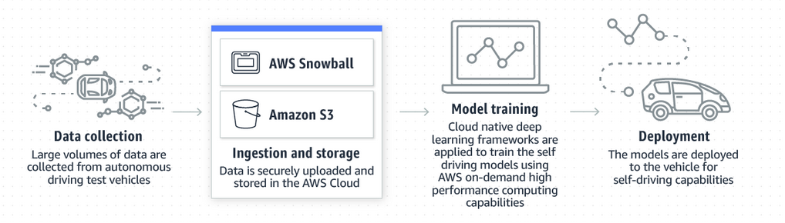
Requirements
Economical
Eco-friendly
Efficient
Source: Autonomous vehicle development
https://aws.amazon.com/automotive/autonomous-driving/

Slide 24
Efficient computation
The industry continues to explore the borders of DL efficiency
GPUDirect technology by Nvidia is improving the speed
Large scale GPU cluster is a reality
Data mobility, collaboration, and easy of access

Slide 25
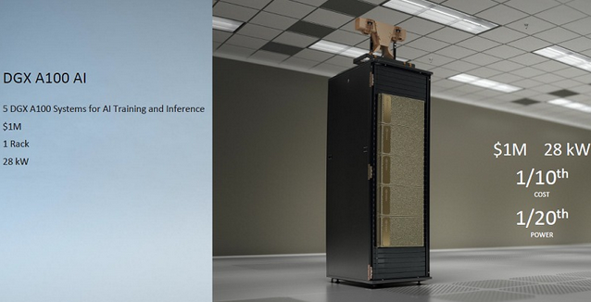
Nvidia DGX A100 AI
Requirements
Economical
Eco-friendly
Efficient
16 A100 Tensor core GPUs each unit
5 PetaFLOPs of AI performance

Slide 26
Data mobility
Requirements
Economical
Eco-friendly
Efficient
Simulation, modeling and training
Efficient pipelines between tiers, phases, stages
Simulation
Control Model development
AI training
Data Ingestion and preparation
Cleaning
Tagging
Training data
Road test Data collection
Huawei Servers Compute and VDI
ArcticOcean like storage box
Storage Link
Distributed NAS
Object, HDFS
OceanStor 100D
NAS on all-flash Dorado
Backup and archive
Storage Link
Distributed NAS
Object, HDFS
Software in loop
Hardware in loop
Cloud
OceanStor 100D
SONY optical disk archive
Backup and Archiving
Verification in lab

Slide 27
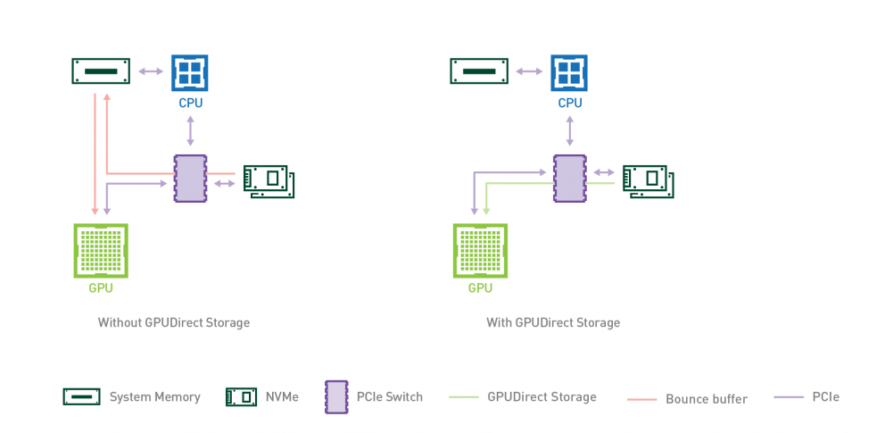
GPU Direct Storage (GDS)
Requirements
Economical
Eco-friendly
Efficient
GDS v0.9 just released Nov 2020
Reference numbers in the industry:
DGX-2 Non-GDS: <40GB/s with high CPU util. rate, average 20GB/s.
DGX-2 GDS: 53GB/s with 16 drives
WekaIO GDS: >80GB/s (100GB with dual ports)
Vast GDS: >90GB/s peak
Data collected from web, may change
Resource : https://developer.nvidia.com/gpudirect

Slide 28

Nvidia SuperPod
Requirements
Economical
Eco-friendly
Efficient
Can be connected with external storage systems such as DDN, WekaIO, and Vast.
Verified scalability up to 140 A100 systems
Groups of 20 A100 systems (Pay as you grow model)
GPU fabrics connected by Mellanox network and GPUDirect RDMA
Can be installed in 3 months

Slide 29
Gaps for market readiness
Pay-per-use model readiness for production
Data mobility among ArcticOcean/100D/Dorado/public clouds
Integration to support Ecosystems (GPUs, DGX, software stack, etc)
ArcticOcean customization for vehicles and ruggedization

